Slide 1


Digital
Portfolio
Next Slide

Slide 2
STUDENT NAME : T. YASHIKA
REGISTER NO AND NMID : 2428K0072/asbrubd2428k007
DEPARTMENT : BSC CS(AI&DS)
COLLEGE : SHREE VENKATESHWARA ARTS
&SCIENCE (CO-ED)
COLLEGE.
UNIVERSITY : BHARATHIYAR UNIVERSITY
Next Slide

Slide 3

Project Title
Digital Portfolio
Next Slide

Slide 4
Agenda
Program Statement
Project Overview
End Users
Tools and Technologies
Portfolio Design and Layout
Features and Functionality
Result and Screenshot
Github link
Conclusion
Next Slide

Slide 5
Problem Statement
In today’s academic and professional environment, students are expected to showcase their skills, achievements, and learning experiences in a structured and accessible manner. Traditional resumes and transcripts often fail to capture the depth of a student’s capabilities, such as projects, extracurricular activities, certifications, and creative work.
Next Slide

Slide 6
Project Overview
Objective: Designed and developed a mobile app that helps students organize study schedules, set reminders, and track productivity. The goal was to reduce missed deadlines and improve time management for university students ,helping connect with teachers an collaborators.
Next Slide

Slide 7
End Users
1. Potential Employers: To showcase skills, experience, and accomplishments to potential employers, demonstrating fit for a role or industry.
2. Academic Advisors: To track progress, identify areas for improvement, and inform academic planning.
3. Faculty Members: To assess student learning, provide feedback, and evaluate project-based assignments.
Next Slide

Slide 8
4. Scholarship Committees: To demonstrate achievements, potential, and merit for scholarship consideration.
5. Graduate School Admissions: To showcase academic achievements, research experience, and potential for graduate-level work.
6. Personal Reflection: For students to reflect on their own growth, progress, and learning journey.

Slide 9
Tools and Technology
A student portfolio is a digital or physical collection of a student’s work that showcases their skills, achievements, and learning progress. To make it effective, different tools and technologies are used depending on whether it is digital or traditional.
WEBSITE:-
GITHUB : For coding and software development
portfolios.
Next Slide

Slide 10
Programming & Technical Tools :-
HTML, CSS, JavaScript → To build custom portfolio websites. Frameworks like React, Angular → For interactive web portfolios. Data visualization tools (Tableau, Excel, Python libraries like Matplotlib/Seaborn) → Show data analysis projects.
HTML provide a structure of portfolio,CSS give style and colours ,JAVASCRIPT it helps to interactive performance of portfolio. Codepen: Coding platform
Next Slide

Slide 11
PORTFOLIO DESIGN AND LAYOUT
A student portfolio is a personal collection of work, projects, and achievements that showcases your skills, learning progress, and personality. It can be digital (website, PDF, presentation) or physical (binder, printed book).
About me
Education &Achievements
Contact Information and etc...
Next Slide

Slide 12
Features and Functionality
Profile Section Personal details (name, photo, contact info, short bio) .
Academic background (schools, degrees, GPA, certifications) .
3. Skills & competencies (technical, creative, soft skills) .
Next Slide

Slide 13
Work Showcase Projects (with descriptions, images, videos, or live demos)
Research papers or case studies Artwork, designs, code repositories, writing samples Group vs. individual projects
Networking & Contact Options LinkedIn/GitHub/Behance/Dribbble links Contact form or email integration
Functionality :-
Next Slide

Slide 14
Responsive Design – works smoothly on desktop, tablet, and mobile.
Smooth Navigation – sticky navbar, scroll-to-section, or hamburger menu for mobile.
Project Showcase – interactive project cards with images, descriptions, and links (GitHub, live demo).
About Section – a personal intro, background, skills, and values.
Contact Section – contact form, social media links, and email integration.
Next Slide

Slide 15
6. Dark/Light Mode Toggle – improves accessibility and aesthetics.
7. Search & Filter – let users filter projects by category (e.g., web, design, AI).
8. Downloadable Resume – a button to download your CV in PDF.
9. Animations & Transitions – smooth fade-ins, hover effects, or Framer Motion animations.
10. Interactive Skills Section – progress bars, charts, or tags for tech stacks.
Next Slide

Slide 16
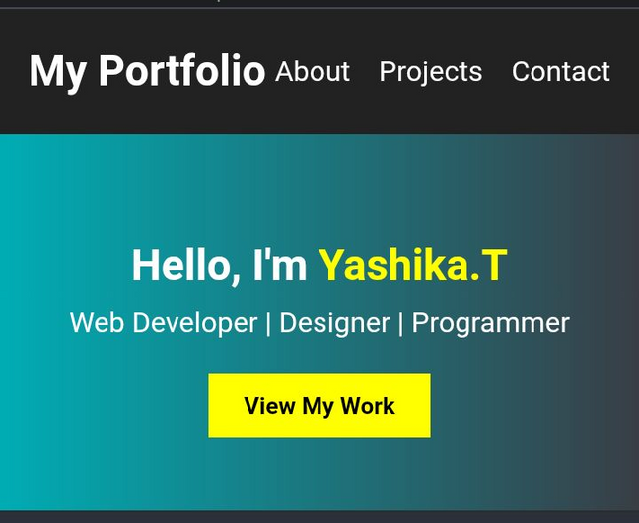
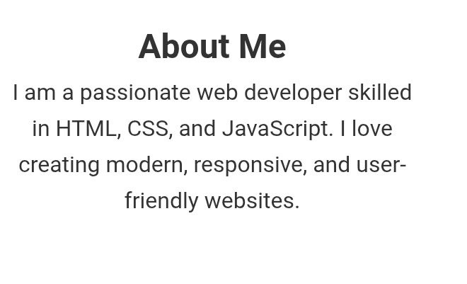
Results and Screenshots
Next Slide

Slide 17
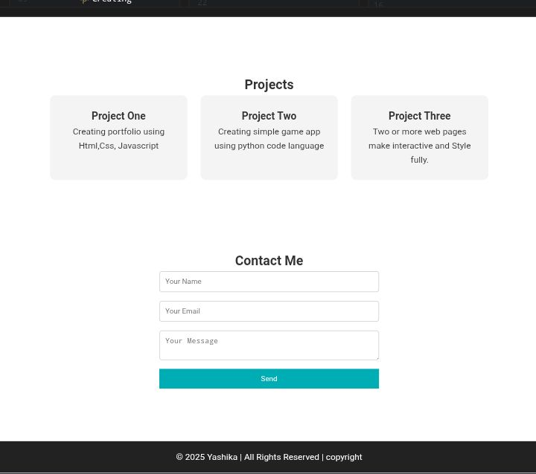

Slide 18
Github Link
https://github.com/yashika302006/My-portfolio.git

Slide 19
Conclusion
"In conclusion, this portfolio showcases my academic journey, highlighting my growth, achievements, and
skills developed throughout my studies. I'm proud of the work I've accomplished and look forward to applying these skills in future endeavors."

Slide 20
Thank
You!!

